Slide 1
Values, Quantities & Units
SMIF
Modeling values, quantities and units in conceptual & application models
As defined in
Semantic Modeling for Information Federation (SMIF)
This File: https://github.com/ModelDriven/SIMF/blob/master/Presentations/Values%2C%20Quantities%20%26%20Units.pptx

Slide 2
Scope
Values are distinguished from “identifiable entities”
Values
Values have an identity identical with their value/content (represented in any way)
Values are Immutable and non-temporal (the number 5 just “is”)
Different representations of the same value represent the same value universally
Quantities – amounts of things measured in any way
JCGM: property of a phenomenon, body, or substance, where the property has a magnitude that can be expressed as a number and a reference
Example: 5kg of fish
Consider also “counts of things” – e.g. 5 fish.
Units – accepted by convention as representing kinds of quantities
JCGM: real scalar quantity, defined and adopted by convention, with which any other quantity of the same kind can be compared to express the ratio of the two quantities as a number
Example: Kilogram
Representations in conceptual, logical and physical models/schema

Slide 3
Core Definitions (JCGM 200:2008)
Quantity : property of a phenomenon, body, or substance, where the property has a magnitude that can be expressed as a number and a reference
Value of a quantity: value number and reference together expressing magnitude of a quantity
Also DOLCE/Guizzardi “Quale”
Measurement unit (unit of measurement unit) :real scalar quantity, defined and adopted by convention, with which any other quantity of the same kind can be compared to express
Kind of quantity (quantity kind): aspect common to mutually comparable quantities
Also DOLCE /Guizzardi “Quality Space”

Slide 4
Why Model Values, Quantities and Units?
Many models have “int” and “String” as the types of Characteristics of things
This does not represent their semantics, only how they are represented in the computer
Values have semantics beyond their representation as strings or numbers
E.g. a social security number has source, uniqueness and identity implications
E.g. An exchange rate on the London and N.Y. exchanges are not the same
Programming example: Assigning a “description (string)” to a “name (string)” is an error.
Examples of unit confusion are well known
E.g. First mars lander crashes due to unit confusion
When consuming, federating or translating data it is dangerous to be unsure what the data represents
Different representations of the same concepts may use or expect different units expressed in different ways
So to federate, integrate and translate – value kinds & units as well as the concepts they represent must be clear and consistent across independent models
But, specifying units in conceptual reference models is over-commitment and ignores “local needs and conventions”
Making values, quantities and units “first class” in a language encourages use and consistency.
Using the MDA (Model Driven Architecture) pattern allows implementation diversity
libraries of common value types and units allows for interoperability and reuse

Slide 5
Goals
Values should be distinguished from identifiable entities and their constraints enforceable
However, values and identifiable entities should be in a unified type system
Reusable concept libraries should includes common quantities and units – use, don’t invent
Definition of values, quantity kinds and units should be part of the modeling language to ensure reuse and semantic integrity
Conceptual models should commit to quantity kinds, but not to units or numeric representations
Application & data models should be able to commit to specific units and/or numeric or non-numeric representations, but should not be forced to do so.
Such models must have a way to specify units assumed or specified
Implementations should be able to be unit specific or agnostic
Therefore, a unit value should be substitutable for the value of a property defined by a quantity kind
In mappings, there must be a way to specify a choice of units and representation

Slide 6
Questions that come up
How are values, quantities and units modeled?
How do these models map to common data representations?
Are currencies and other non-constant measures units?
How do we allow both numeric representation (e.g. “Real”) and unit used to be variable but (potentially) fixed in data schema?
Are kinds of quantities subtypes of primitive types?
Or, do kinds of quantities have some kind of “magnitude” property?
How does an intuitive conceptualization align with the formal definitions?

Slide 7
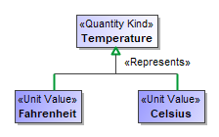

Quantity Kinds & Units in SMIF Profile
For numeric characteristics, we want to know what it means (e.g. Temperature), not the kind of number (Real).
<<Quantity Kind>> is an aspect common to mutually comparable quantities represented by one or more units.
A “unit value” represents a quantity kind, there are multiple units representing temperature.
A physical representation would then represent the unit as some kind of number in a specified unit.

Slide 8
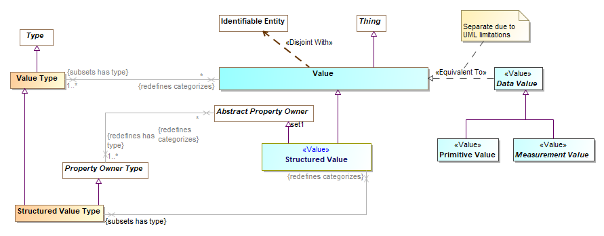
SMIF Values Metamodel & Model
Meta
Model

Slide 9
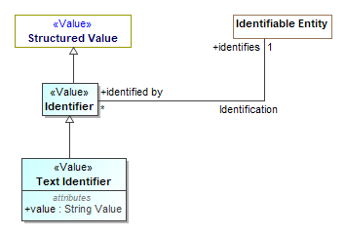
Example of defining some value types

Slide 10
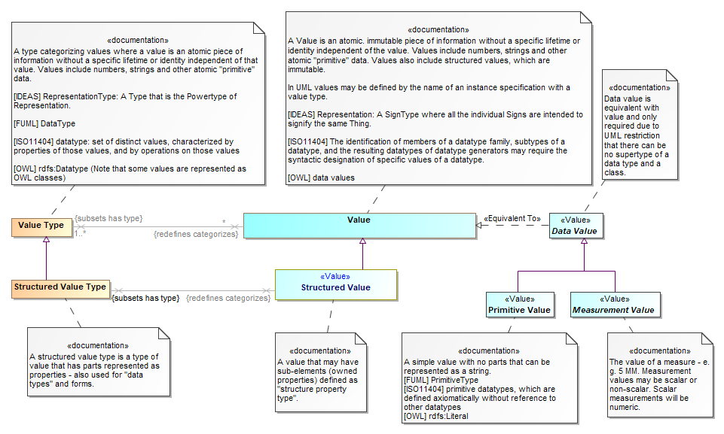
Definitions

Slide 11
Relating quantity values, quantity kinds and units
5kg translates to “5 times (reference to the kg standard)”
More formally: a magnitude (5) times a reference (kg)
Where the reference is actually a quantity based on physics
What this could look like in a model or schema
A Quantity
Quantity kind: Mass
Reference: kg (reference to an abstract quantity defined in [NIST-SI])
Defined within a system of units
Has offset and ratio relative to other units in the same system of units
Magnitude: 5 (A scalar value)
In SysML (And FIBO), Quantity kind is defined as a Type (Class)
A Mass (Instance of quantity kind (SysML), Subclass of quantity kind (FIBO))
Reference: kg (reference to an abstract quantity defined in [NIST-SI])
Magnitude: 5 (A scalar value)
Therefore, any “instance” of a quantity will have these two properties
Powertype or “faceted classification” of “Quantity kind”

Slide 12
Some issues with the “two property” representation
There is no inherent way to specify the unit in a logical, information or data model without introducing a new specification theory
It doesn’t seem to correspond with how people conceive of “5kg”
Every data instance will carry the type (Mass) & the unit reference (kg) and the magnitude (5).
This is both expensive and will require a lot of custom code and processing for each instance
There is no corresponding type for information or data models that may be expressed in units, thus no way to specify units in a normal schema

Slide 13
Simplification in SMIF
Unity Type is A Powertype or “faceted classification” of “Quantity kind” & Unit
Principle: Leverage the type system
Introduce “Unit Type”, a type representing all quantities having the same quantity kind and unit
A Unit type is a substitutable representation of a quantity kind
This may be implemented with simple subclassing in data/application models
A Unit type may be used as the type of a property in an information model, data model or mapping. Unit specification uses the type system.
Instances are “Unit Values” - need only carry the type (e.g. kg) and the magnitude (e.g. 5)
Unit values have a hasValue property for the measurement value (magnitude for a scalar) that can also be defined as any measurement type such as “Integer” , “Real” or even a coded value (e.g. Blue) or (RGB:68,114,96)
However this could map to other implementations

Slide 14
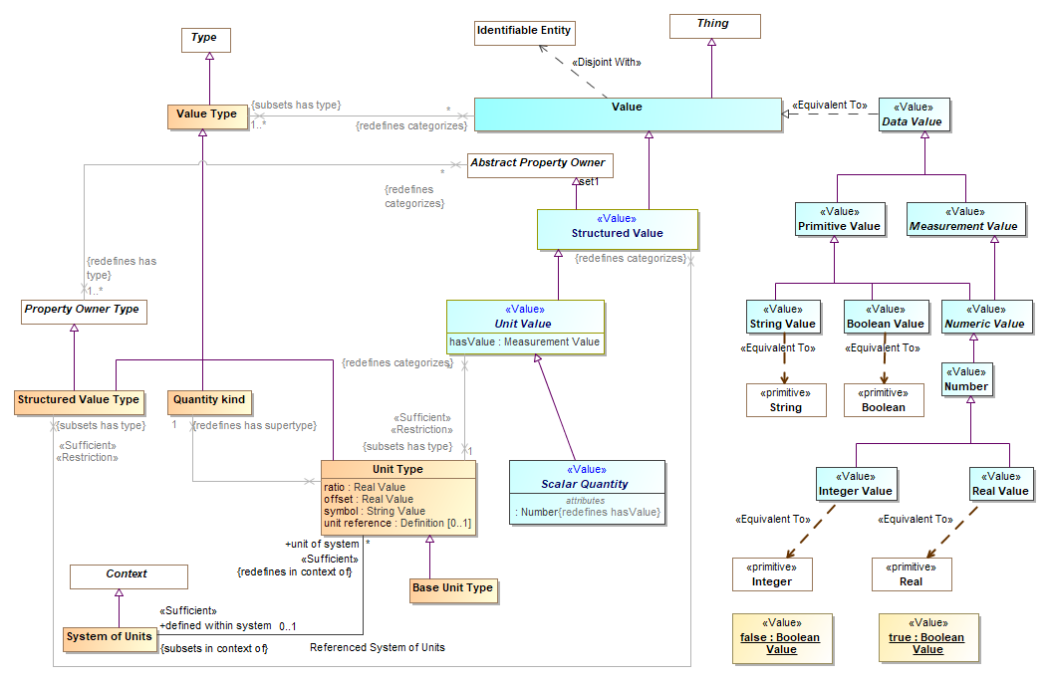
Values, Units & Quantity Models
Focus on Units and Unit Values

Slide 15
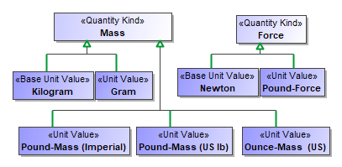

Modeling Quantity Kinds & Units
Substitutable Representation
Characteristics
Schema can specify a unit
Defined using quantity kinds
Ground facts use units

Slide 16
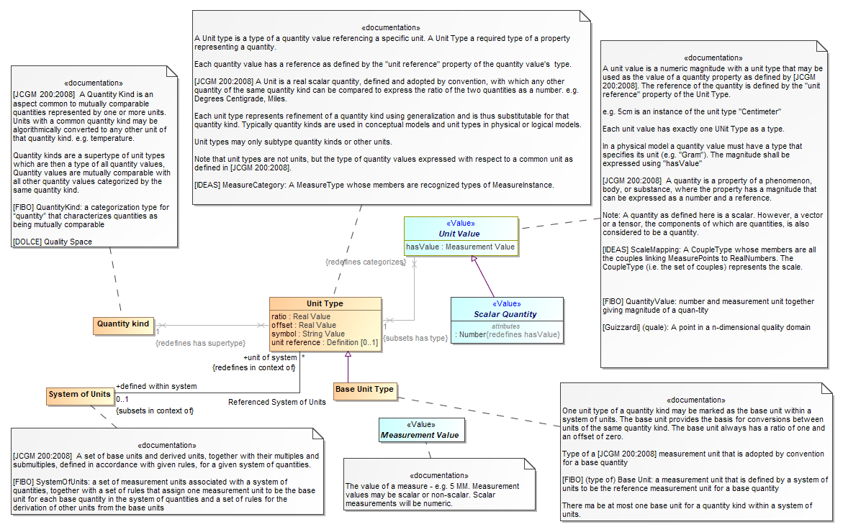
Definitions

Slide 17
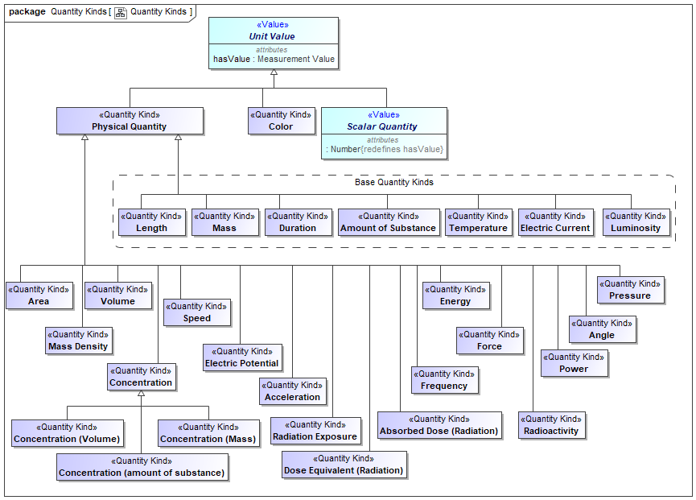
Physical Quantity Kinds (SI & NIST)
Concept library – not in SMIF

Slide 18
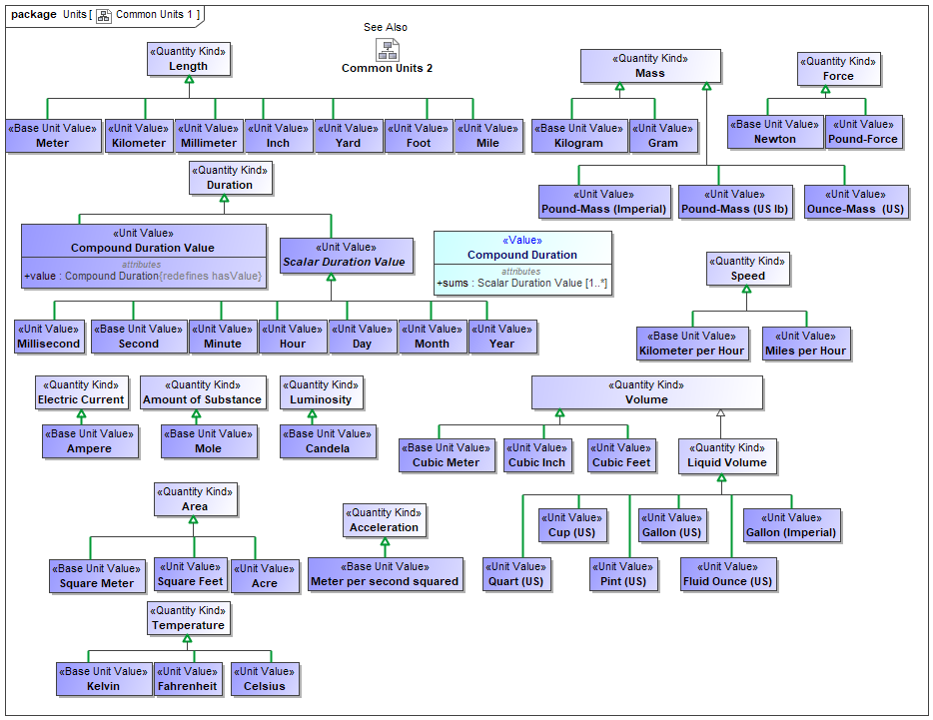
Physical Unit Types (SI & NIST)

Slide 19
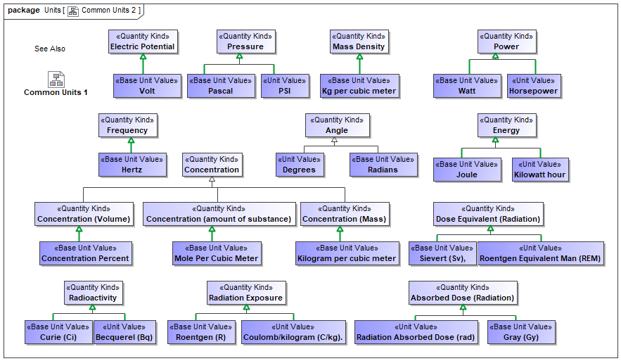

Slide 20
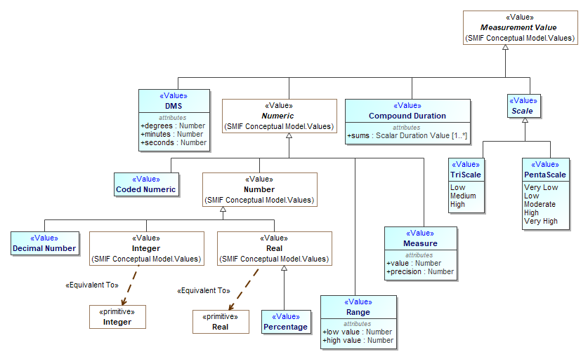
Other ways of measuring

Slide 21
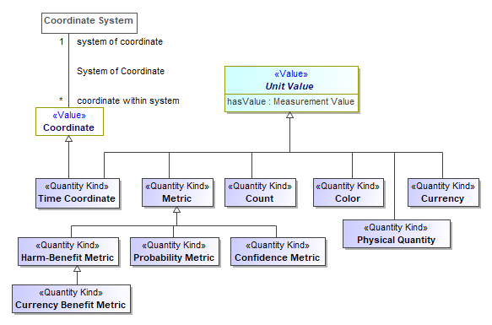
Other Kinds of Quantities

Slide 22
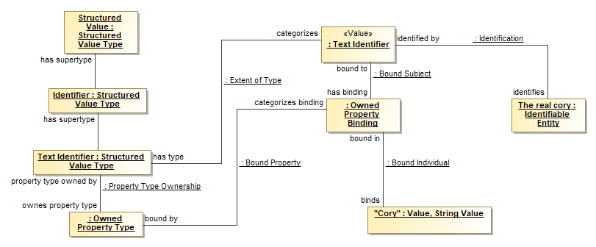
Value Instance Example “Cory” is an identifier for an identifiable entity
Model
“Ground Facts”

